Slide 1

VIGNESH V
GIF STEGANOGRAPHY
3/21/2024 Annual Review
1

Slide 2

PROJECT TITLE
Implementation of GIF steganography using python
3/21/2024 Annual Review
2

Slide 3



AGENDA
Research and Understanding: Begin by studying the principles of steganography and the GIF file format. Understand how GIF images are structured and how data can be hidden within them without perceptible changes.
Technique Selection: Explore different steganographic techniques suitable for GIF images. This could include LSB embedding, palette modification, or other methods tailored for GIFs.
Implementation: Develop software or scripts to encode messages into GIF images and decode them back. This involves writing algorithms to manipulate pixel data or color palette entries while maintaining image integrity.
Testing and Evaluation: Test your steganographic techniques with various GIF images and message sizes. Evaluate the effectiveness of your method in terms of message capacity, robustness to compression, and resistance to detection.
3/21/2024 Annual Review
3

Slide 4

PROBLEM STATEMENT
The problem statement for your GIF steganography project is to develop a method to embed secret messages within GIF images while maintaining their visual integrity. This involves exploring techniques to hide data within the image without altering its appearance perceptibly. The challenge lies in finding efficient methods to encode and decode messages in GIF format, ensuring robustness against detection and resistance to data loss during compression. The project aims to provide a secure and covert communication channel
using GIF images as carriers for hidden information.
3/21/2024 Annual Review
4

Slide 5

PROJECT OVERVIEW
The project aims to implement a system for steganographic communication using GIF images as carriers for hidden messages. This involves researching steganography principles and the GIF file format, selecting appropriate techniques such as LSB embedding or palette modification, and developing algorithms for encoding and decoding messages. The system will be tested with various GIF images to evaluate its capacity, robustness, and resistance to detection. Documentation of the process and results will be provided, along with potential avenues for future exploration and improvement.
3/21/2024 Annual Review
5

Slide 6

WHO ARE THE END USERS?
End users of gif steganography can vary widely depending on the context and purpose of its use. Here are some potential end users:
Security Professionals: Security experts may use GIF steganography for covert communication, such as exchanging sensitive information or intelligence securely.
Journalists and Whistleblowers: Individuals working in journalism or whistleblowing may utilize GIF steganography to protect their sources or transmit information anonymously.
Privacy Advocates: People concerned about privacy may employ GIF steganography to hide personal messages or data within seemingly innocuous images, safeguarding their information from unauthorized access.
Digital Artists: Creatives may experiment with GIF steganography as a form of artistic expression, embedding hidden messages or layers of meaning within their artwork.
Educational Purposes: Students and researchers studying cybersecurity, cryptography, or digital forensics may explore GIF steganography as a learning tool to understand covert communication techniques and their implications.
3/21/2024 Annual Review
6

Slide 7

SOLUTION AND ITS VALUE PROPOSITION
The solution involves developing a steganographic system capable of hiding messages within GIF images while preserving their visual quality. This system will employ techniques such as LSB embedding or palette modification to encode messages into the image data discreetly.
Value Proposition:
Enhanced Security: By combining encryption and steganography, our solution provides a high level of security for sensitive information, safeguarding it from unauthorized access, interception, and tampering.
Covert Communication: Our system enables users to communicate covertly through innocuous-looking images, offering a discreet and inconspicuous method of sharing confidential messages without arousing suspicion.
3/21/2024 Annual Review
7

Slide 8
SOLUTION AND ITS VALUE PROPOSITION
Privacy Protection: With our solution, individuals and organizations can protect their privacy and confidentiality by securely transmitting sensitive information while mitigating the risk of exposure or interception by adversaries.
Versatile Applications: Our image steganography system has diverse applications across various sectors, including government, military, business, journalism, activism, and personal privacy, empowering users to securely communicate and share information across different domains.
Compliance and Regulation: Our solution helps organizations adhere to regulatory requirements and compliance standards concerning data protection and privacy by providing a secure and auditable communication channel for sensitive information exchange.
3/21/2024 Annual Review
8

Slide 9

THE WOW IN YOUR SOLUTION
The "wow" factor in this solution lies in its ability to seamlessly embed secret messages within ordinary GIF images, effectively turning them into covert carriers of information. This capability opens up endless possibilities for secure communication, as GIF files are ubiquitous and often overlooked as potential vehicles for hidden data. The system's versatility, combined with its robustness against detection and resistance to data loss, makes it a powerful tool for clandestine communication and digital secrecy.
3/21/2024 Annual Review
9

Slide 10
MODELLING
1. System Architecture: Define the overall structure of the steganographic system, including modules for encoding, decoding, and interface components.
2. Data Flow Diagrams: Illustrate how data (messages and GIF images) will flow through the system, depicting processes such as message encoding, embedding into GIF images, and decoding.
3. Class Diagrams: Identify the key classes and their relationships within the system, such as classes for image manipulation, message encoding, and decoding algorithms.
4. Sequence Diagrams: Outline the sequence of interactions between system components during message encoding and decoding processes, highlighting the steps involved in each operation.
5. User Interface Mockups: Design mockups of the user interface for interacting with the steganographic system, including options for selecting GIF images, inputting messages, and viewing encoded/decoded results.
6. Testing and Validation Plans: Define strategies for testing the system's functionality, including unit tests for individual components and integration tests for the system as a whole. Validation plans should ensure that encoded messages are successfully hidden within GIF images and can be reliably decoded.
3/21/2024 Annual Review
10

Slide 11
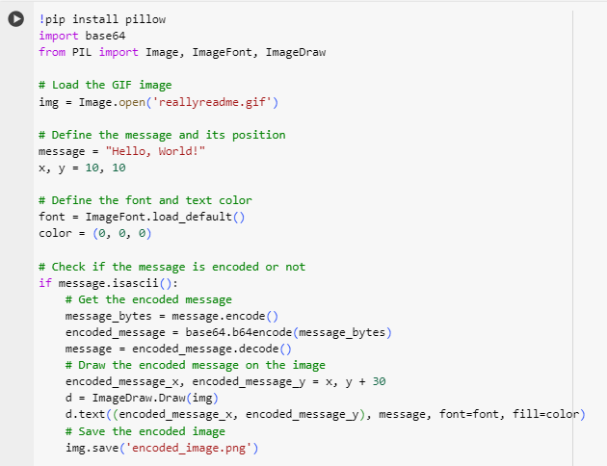
MODELLING
3/21/2024 Annual Review
11

Slide 12
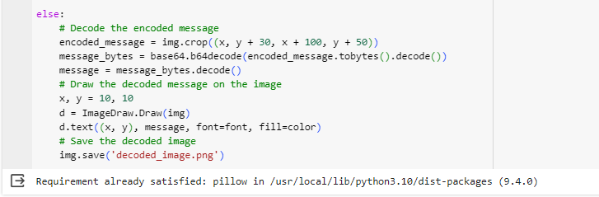
MODELLING
3/21/2024 Annual Review
11

Slide 13
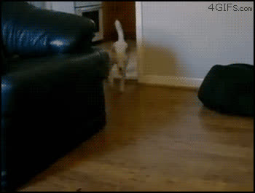
MODELLING
reallyreadme.gif
INPUT GIF
3/21/2024 Annual Review
11

Slide 14
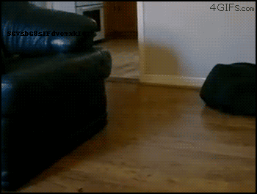

MODELLING
encoded_image.png
OUTPUT SAVED
IMAGE
3/21/2024 Annual Review
11

Slide 15
RESULTS
The result of the project would be a fully functional steganographic system capable of embedding secret messages within GIF images and reliably decoding them back without perceptible loss of image quality. Users would be able to interact with the system through a user-friendly interface to encode messages into GIF files and decode hidden messages from existing GIF images. The system would demonstrate its effectiveness through comprehensive testing, showing its capacity to hide messages securely, resist detection, and maintain robustness against compression and image alterations. Additionally, documentation of the project's process, including methodologies, challenges faced, and results obtained, would be provided to facilitate understanding and future development.
3/21/2024 Annual Review
12

